Slide 1



Real-time Identification of Simple and Extended Musical Chords using Artificial Neural Networks
R3 A09
Brain Blast 2019
Navarro, Joachim Alfonso A. Coronel, Lesli Natasha A.
D
B
E minor 7
G
E

Slide 2

Has this ever happened to you?
What’s the chords of this song?

Slide 3


We do what we have to do

Slide 4
What if the song wasn’t too popular?
OK Google, what are the chords of this song?
My apologies… I don’t understand.

Slide 5
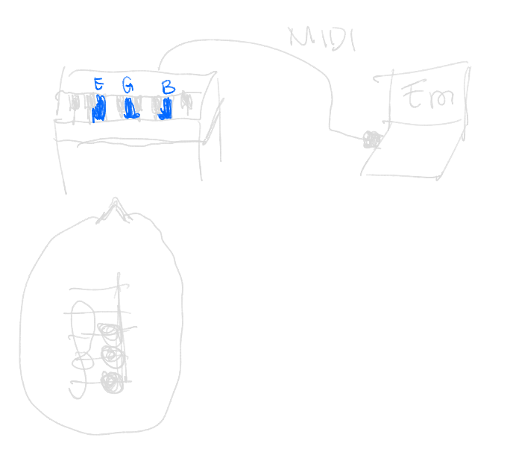
What if a machine could do it?

Slide 6
What is a chord?
G
Collection of two or more notes
E
C
C major

Slide 7
What is a chord?
Collection of two or more notes
G
E
C
Usually played together
C major

Slide 8
What is a chord?
G
Sound like they make sense
E
C
Leino, Brattico, Tervaniemi, & Vurst, 2007
C major

Slide 9
How is a chord named?
G
Its root note…
E
C
C major

Slide 10
How is a chord named?
Its root note…
G
E
and its chord type
C
C major

Slide 11

Chord identification:
Naming chords by knowing their notes
D
That’s an
F major 13 (#11)
B
G
E
C
A
F

Slide 12
…And we’re expecting a computer to do that?
Artificial Neural Networks!

Slide 13
Artificial Neural Networks (ANNs)
1

Slide 14
Artificial Neural Networks (ANNs)
Sanderson, 2017
Nielsen, 2015
Colina, Perez, & Paraan, 2017
1

Slide 15
Artificial Neural Networks (ANNs)
Sanderson, 2017
Nielsen, 2015
Colina, Perez, & Paraan, 2017
1

Slide 16
Artificial Neural Networks (ANNs)
Sanderson, 2017
Nielsen, 2015
Colina, Perez, & Paraan, 2017
0.5
Magic math bag

Slide 17
Artificial Neural Networks (ANNs)
Sanderson, 2017
Nielsen, 2015
Colina, Perez, & Paraan, 2017
0.5
Magic math bag
Magic math bag 2

Slide 18
Artificial Neural Networks (ANNs)
Sanderson, 2017
Nielsen, 2015
Colina, Perez, & Paraan, 2017
0.7
Magic math bag
Magic math bag 2

Slide 19
Artificial Neural Networks (ANNs)
Sanderson, 2017
Nielsen, 2015
Colina, Perez, & Paraan, 2017
This layout is a simple neural network

Slide 20
Artificial Neural Networks (ANNs)
Sanderson, 2017
Nielsen, 2015
Colina, Perez, & Paraan, 2017
But real ones look more like this

Slide 21
Artificial Neural Networks (ANNs)
Sanderson, 2017
Nielsen, 2015
Colina, Perez, & Paraan, 2017
This neural network can be trained…

Slide 22

Artificial Neural Networks (ANNs)
Sanderson, 2017
Nielsen, 2015
Colina, Perez, & Paraan, 2017
to output certain numbers…

Slide 23
Artificial Neural Networks (ANNs)
Sanderson, 2017
Nielsen, 2015
Colina, Perez, & Paraan, 2017
First bag
Input
Correct output
1
0.7
0.9
0.3
0.8
0.6
...
...
using a training dataset

Slide 24
Artificial Neural Networks (ANNs)
Sanderson, 2017
Nielsen, 2015
Colina, Perez, & Paraan, 2017
Second bag
Input
Correct output
1
0.2
0.9
0.4
0.8
0.1
...
...
which contains answers for all “bags”.

Slide 25
Artificial Neural Networks (ANNs)
Sanderson, 2017
Nielsen, 2015
Colina, Perez, & Paraan, 2017
QUIZ! First bag
Input
Correct output
1
0.9
0.8
...
...
The network is then tested using a validation dataset

Slide 26
Artificial Neural Networks (ANNs)
Sanderson, 2017
Nielsen, 2015
Colina, Perez, & Paraan, 2017
QUIZ! First bag
Input
Correct output
1
0.4
33% accuracy
0.9
0.7
0.8
0.3
...
...
The network tries to answer and may get wrong answers.

Slide 27
Artificial Neural Networks (ANNs)
Sanderson, 2017
Nielsen, 2015
Colina, Perez, & Paraan, 2017
33
45
62
84
96
QUIZ 1
QUIZ 2
QUIZ 3
QUIZ 4
QUIZ n
So it trains again and again…

Slide 28
Artificial Neural Networks (ANNs)
Sanderson, 2017
Nielsen, 2015
Colina, Perez, & Paraan, 2017
33
45
62
84
96
QUIZ 1
QUIZ 2
QUIZ 3
QUIZ 4
QUIZ n
until its score is high enough.

Slide 29
Artificial Neural Networks (ANNs)
Sanderson, 2017
Nielsen, 2015
Colina, Perez, & Paraan, 2017
33
45
62
84
96
EPOCH 1
EPOCH 2
EPOCH 3
EPOCH 4
EPOCH n
1 train-test cycle = 1 epoch

Slide 30
Why use ANNs for chord identification?
Osmalskyj, Embrechts, Piérard, & Van Droogenbroeck, 2012
Major
only used
Perera & Kodithuwakku, 2005
Minor
Zhou & Lerch, 2015
Successfully implemented their chord-identifying ANNs

Slide 31
Can an ANN handle these 37 chord types?
Major
Major 7
Major 9
Major 11
mM7
M6
Minor
Minor 7
Minor 9
Minor 11
mM9
m6
Dom 7
Dom 9
Dom 11
M11sus2
M9sus2
M9sus4
sus2
sus4
7sus2
7sus4
M7sus2
M7sus4
aug
aug7
aug9
aug11
M6(9)
m6(9)
dim
dim7
ø7
dim9
11sus2
9sus2
9sus4

Slide 32

Esp. when songs can use many chord types?
“Slide”
Calvin Harris ft. Frank Ocean & Migos
Amaj7
G#min7
C#min11
F#min9
G#min7
Amaj9

Slide 33
Objectives
Create an ANN capable of identifying our 37 chords

Slide 34
Objectives
…and can respond within 40 ms
Greeff, 2016

Slide 35
Methodology
1
Procurement of software and materials
2
3
Test chord database initialization
Neural network coding / implementation
5
Design of neural network structure
4
Testing and data collection

Slide 36
How did our neural network do?
0.2%
7.5%

Slide 37
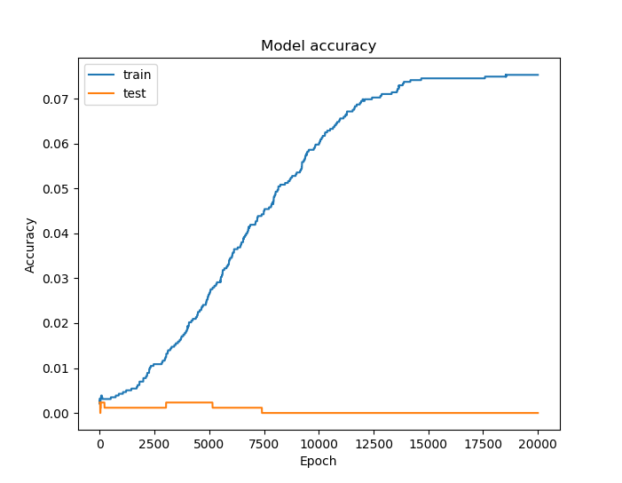
How did our neural network do?
Can’t learn training dataset very well
7.5%
Gives up at 7.5%

Slide 38
How did our neural network do?
Learns just the training dataset
0.2%
“Overfitting”

Slide 39
How did our neural network do?
Significantly better than the 40ms standard
of allowed 40ms

Slide 40
Conclusion
7.5%
4.9ms
Training accuracy increase stopped
More than adequate for live performance

Slide 41
Recommendations
Other machine learning algorithms
Fewer and simpler chords
Use audio rather than MIDI as input
1
2
3

Slide 42
References
Baharloo, S., Service, S., Risch, N., Gitschier, J., & Freimer, N. (2000). Familial aggregation of absolute pitch. American Journal of Human Genetics, 67, 755-758. doi:10.1086/303057.
Chord. (2004). In The concise Oxford dictionary of music (4th ed.) Oxford, UK: Oxford University Press.
Colina, N. C. A., Perez, C. E., & Paraan, F. N. C. (2017). Simple techniques for improving deep neural network outcomes on commodity hardware. AIP Conference Proceedings, 1871, 040001. doi:10.1063/1.4996523.
Daniel, G. (2013). Principles of artificial neural networks (3rd ed.) Chicago, IL: World Scientific.
Fujishima, T. (1999). Realtime chord recognition of musical sound: A system using common Lisp music. Retrieved from http://www.music.mcgill.ca/~jason/mumt621/papers5/fujishima_1999.pdf.
Greeff, W. (2016). The influence of perception latency on the quality of musical performance during a simulated delay scenario. Retrieved from https://repository.up.ac.za/bitstream/handle/2263/58578/Greeff_Influence_2017.pdf?sequence=4.
Humphrey, E., Bello, J. P., & Cho, T. (n.d.). Chord Recognition. Retrieved from http://steinhardt.nyu.edu/marl/research/chord_recognition.
Kidd, P. (2017). pyrtmidi: Real-time MIDI I/O for Python [GitHub repository]. Retrieved August 23, 2017, from https://github.com/patrickkidd/pyrtmidi.
Nickolls, J., Buck, I., Garland, M., & Skadron, K. (2008). Scalable parallel programming with CUDA. ACM Queue, 6(2), 40-53.
Nielsen, M. A. (2015). Neural networks and deep learning. Determination Press.
Osmalskyj, J., Embrechts, J-J., Piérard, S., & Van Droogenbroeck, M. (2012, May 9). Neural networks for musical chords recognition. Retrieved at http://jim.afim-asso.org/jim12/pdf/jim2012_08_p_osmalskyj.pdf.
Perera, N., & Kodithuwakku, S. R. (2005, December 15). Music chord recognition using artificial neural networks. 1st Proceedings of the International Conference on Information and Automation, 304-308.
Root. (2004). In The concise Oxford dictionary of music (4th ed.) Oxford, UK: Oxford University Press.
Sanderson, G. [3Blue1Brown]. (2017, October 5). But what *is* a Neural Network? | Chapter 1, deep learning. Retrieved from https://www.youtube.com/watch?v=aircAruvnKk.
Stark, A. M., & Plumbley, M. D. (2009). Real-time chord recognition for live performance [PDF file]. Retrieved at https://www.eecs.qmul.ac.uk/~markp/2009/StarkPlumbley09-icmc.pdf.
Zatorre, R. J., Perry, D. W., Beckett, C. A., Westbury, C. F., & Evans, A. C. (1998). Functional anatomy of musical processing in listeners with absolute pitch and relative pitch. Proceedings of the National Academy of Sciences, 95, 3172-3177. Retrieved at http://www.pnas.org/content/95/6/3172.full.
Zhou, X., & Lerch, A. (2015). Chord detection using deep learning. 16th International Society for Music Information Retrieval Conference, 52-58. Retrieved at http://ismir2015.uma.es/articles/96_Paper.pdf.
Illustrations by Lesli Coronel

Slide 43
Assets slide
C
C#
D
D#
E
F
B
A#
A
G#
G
F#
C
C#
D
D#
E
F
B
A#
A
G#
G
F#

